Slide 1
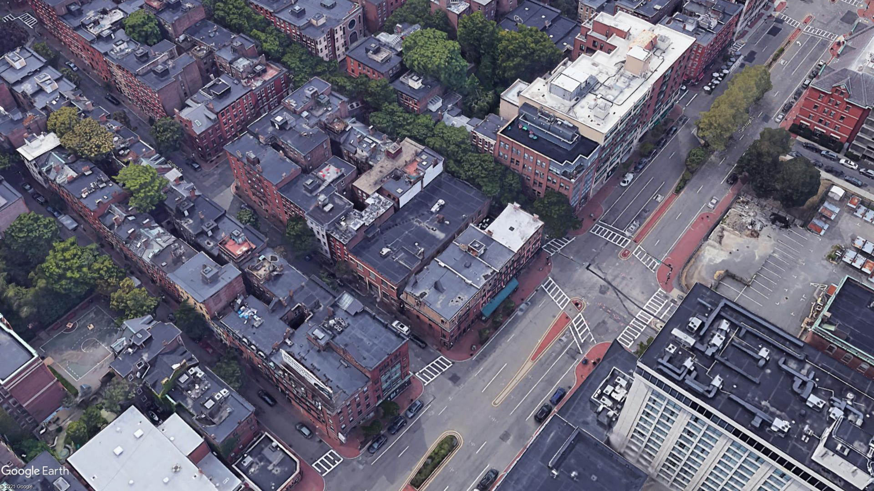
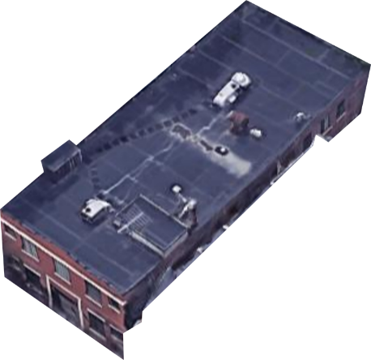
GARDEN ST
12 GARDEN ST
IRVING ST
12 Garden Street Community Meeting
October 26, 2021
CAMBRIDGE ST

Slide 2
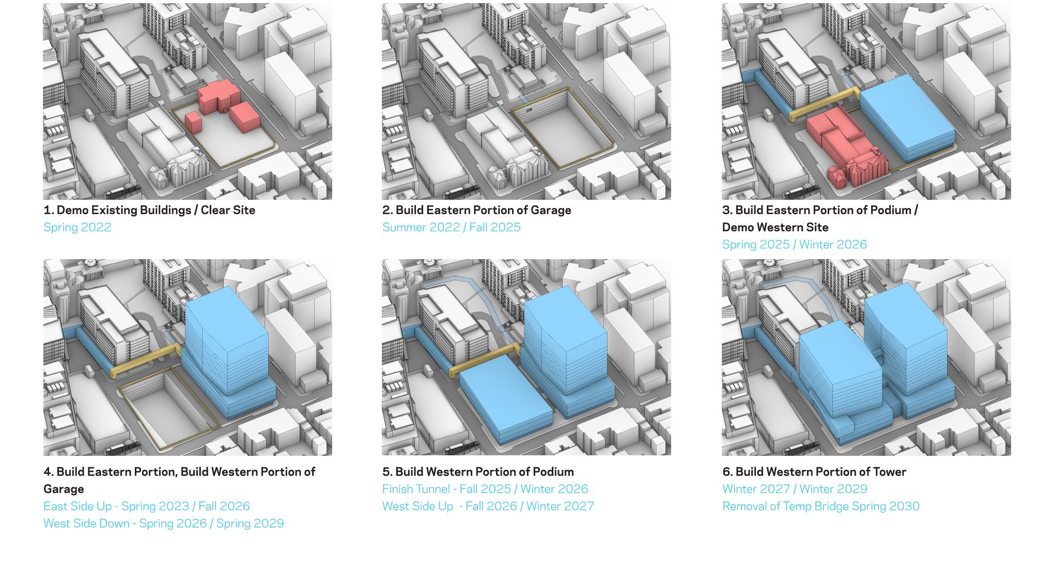
Project Sequence Diagram
3. Build Eastern Portion Podium and Tower / Eastern Garage Occupied / Demo Western Site
4. Eastern Portion Tower and Podium Occupied/ Garage Occupied / Build Western Portion of Garage

Slide 3
Overall Process Timeline
1.
Draft RFP with community input
2.
Issue RFP
3.
Review submissions, make recommendation to award with community input
4.
Designate Developer with community input
5.
Design project / Receive City of Boston zoning + regulatory approvals
6.
Obtain City/State affordable housing funds
7.
Move occupants out of 12 Garden Street - 2030
8.
Transfer property / commence construction

Slide 4
Existing Conditions

Slide 5
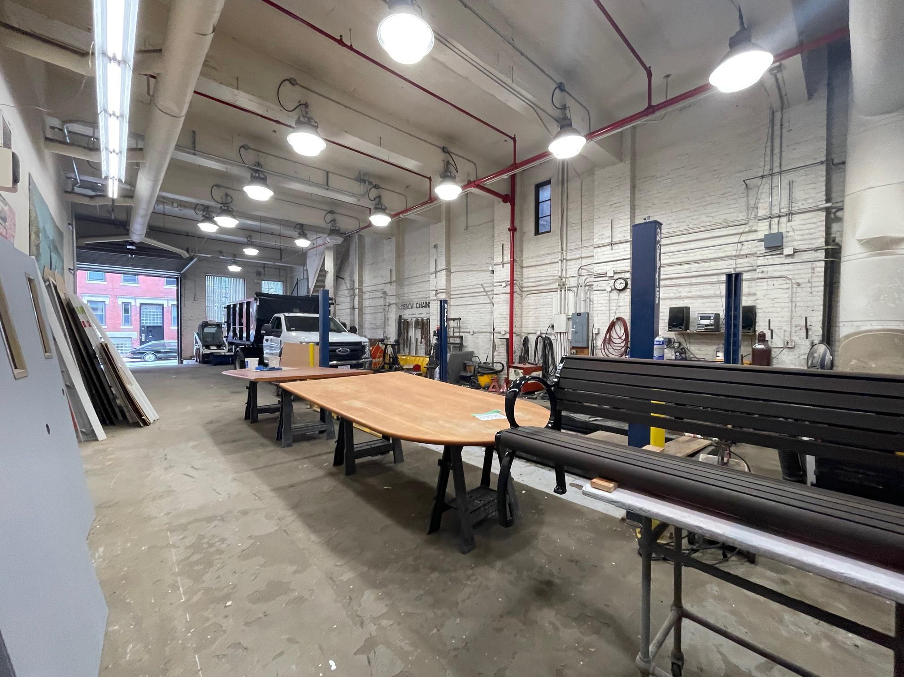
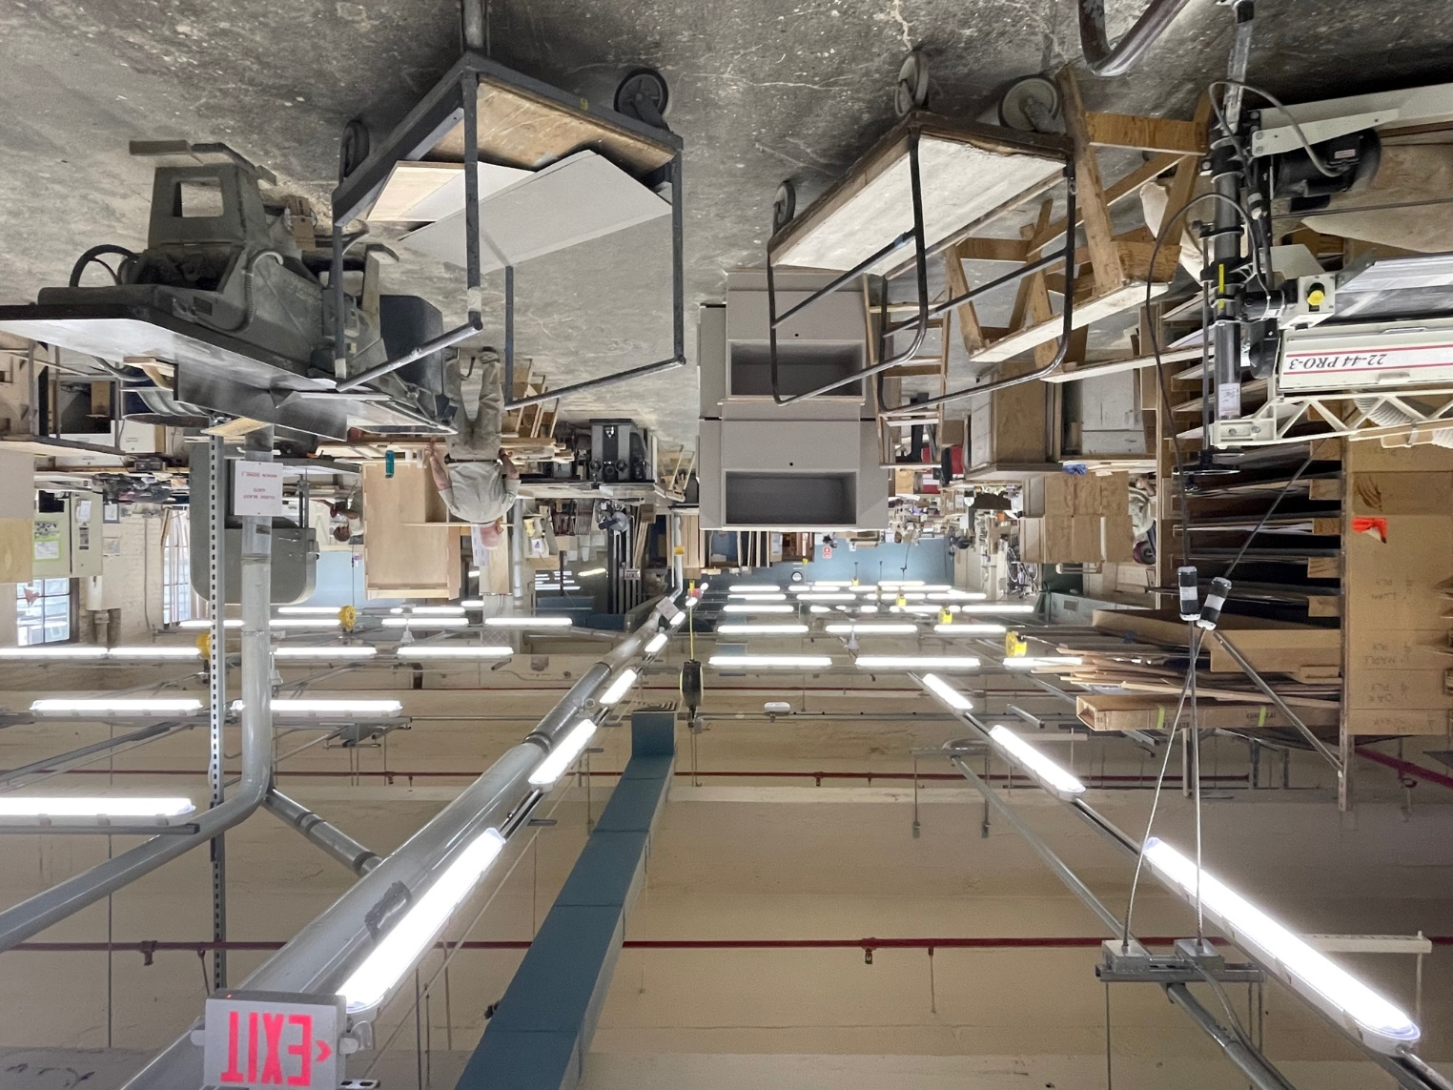
Existing Conditions Interior
Ground Floor
Floor 3
FINEGOLD ALEXANDER ARCHITECTS

Slide 6
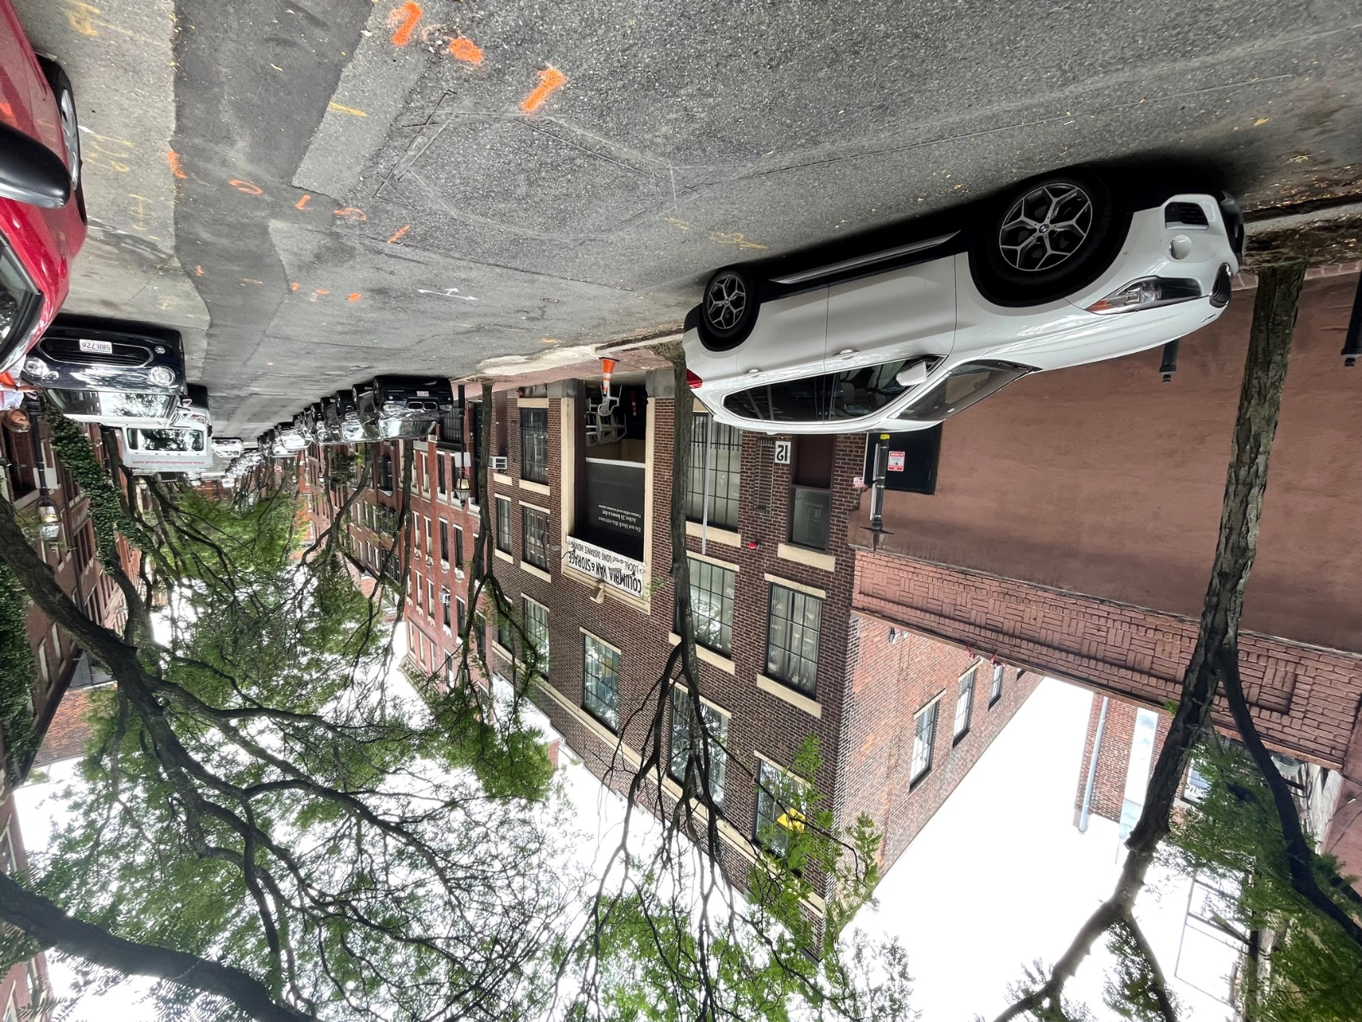
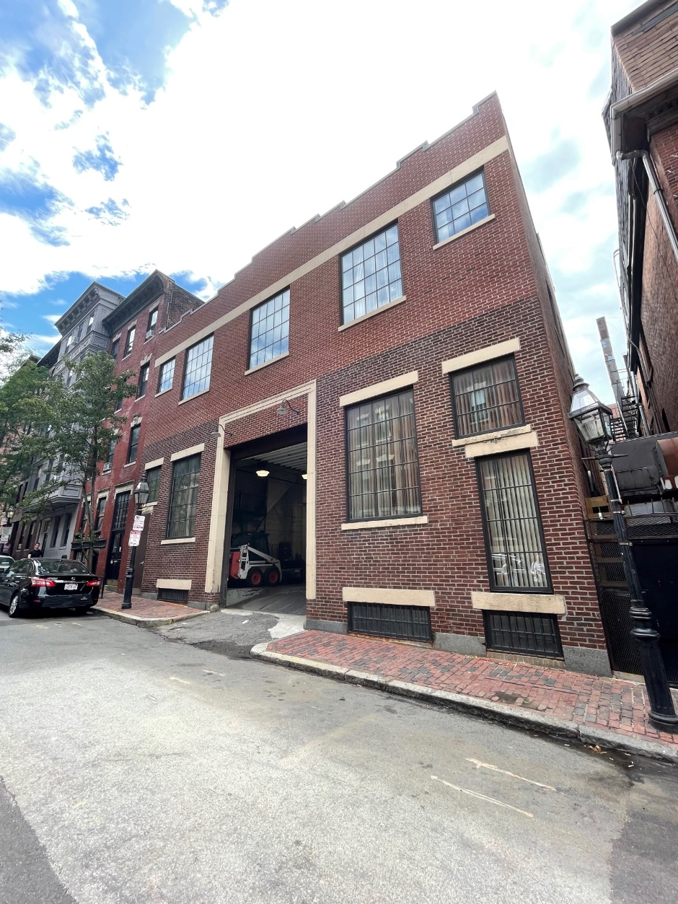
Existing Conditions Exterior
View from Garden Street
View from Irving Street
FINEGOLD ALEXANDER ARCHITECTS

Slide 7
OPTION 1:
All Residential

Slide 8
Option 1 Section
FINEGOLD ALEXANDER ARCHITECTS

Slide 9
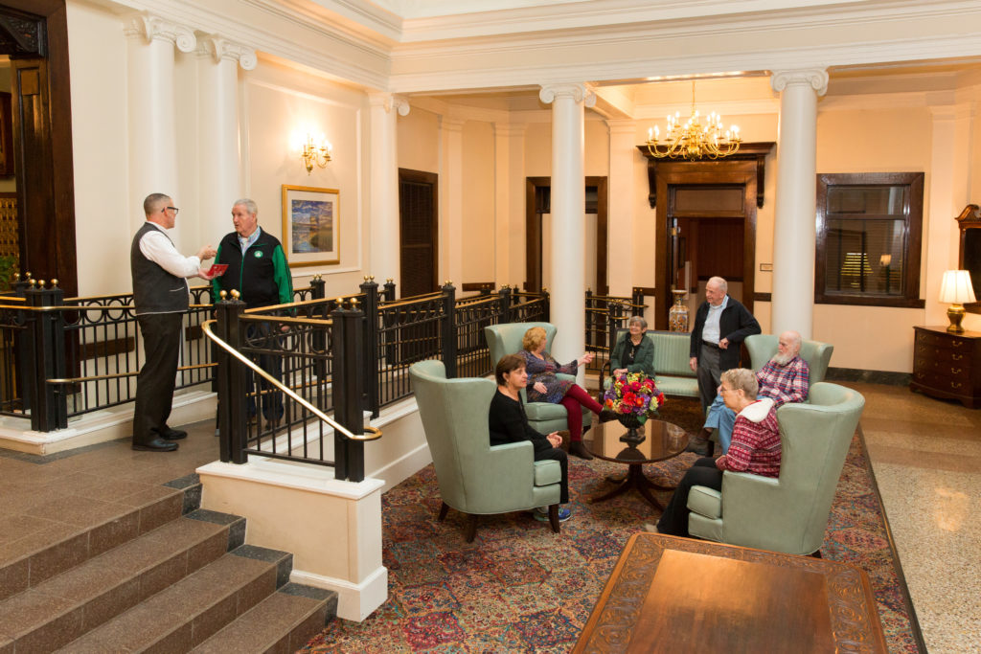
Option 1 Plans
Beacon House Common Space
Basement
FINEGOLD ALEXANDER ARCHITECTS

Slide 10
Option 1 Plans
Irving Street
Proposed window locations
Garden Street
Floor 2
Ground Floor
FINEGOLD ALEXANDER ARCHITECTS

Slide 11
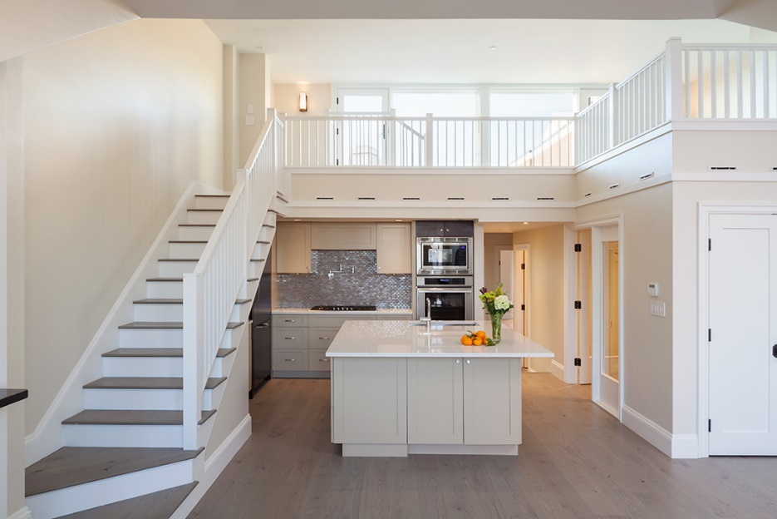
Option 1 Plans
Floor 3
Example Residences
FINEGOLD ALEXANDER ARCHITECTS

Slide 12
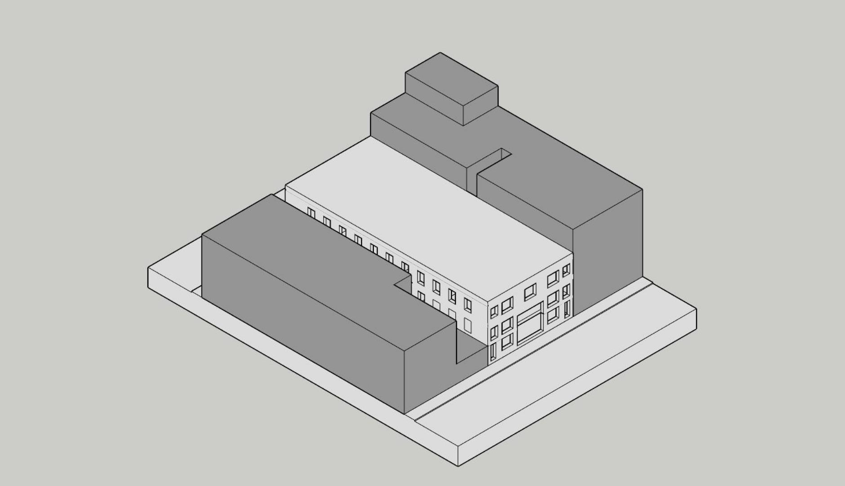
Option 1 Axonometric View
Proposed window locations
ENTRY
GARDEN ST
FINEGOLD ALEXANDER ARCHITECTS

Slide 13
OPTION 2:
Residential With Community Space

Slide 14
Option 2 Section
+/- 18’
FINEGOLD ALEXANDER ARCHITECTS

Slide 15
Option 2
Plans
Basement
Elliot Innovation School – Multipurpose Space
FINEGOLD ALEXANDER ARCHITECTS

Slide 16
Option 2 Plans
Irving Street
Proposed window locations
Example Community Spaces
Garden Street
Floor 2
Ground Floor
FINEGOLD ALEXANDER ARCHITECTS

Slide 17
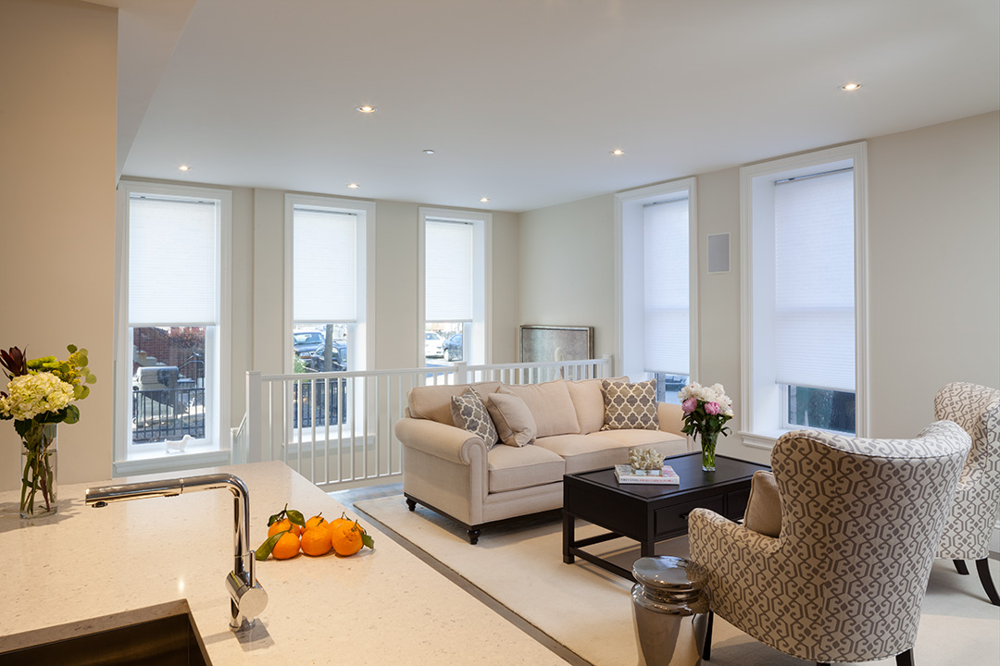
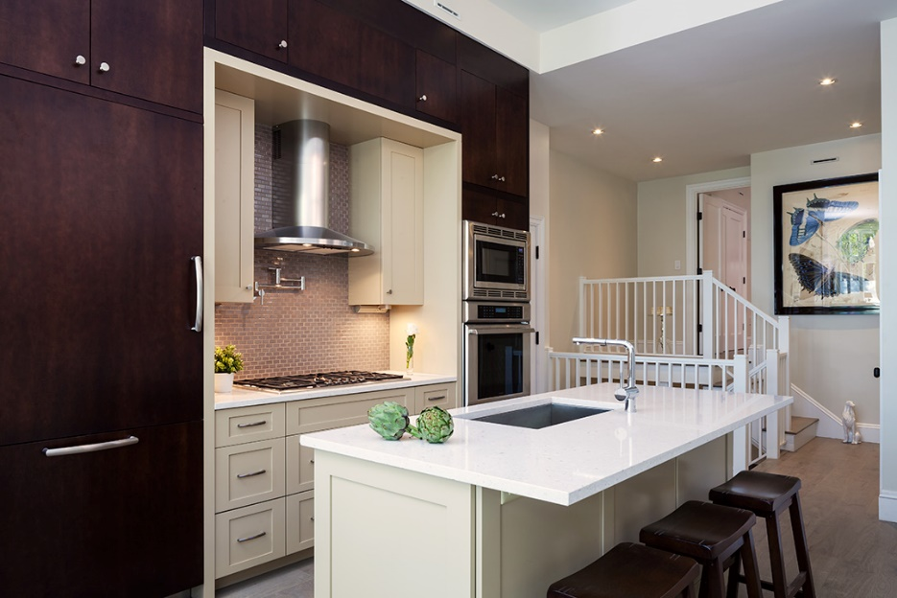
Option 2 Plans
Floor 3
Example Residences
FINEGOLD ALEXANDER ARCHITECTS

Slide 18
Option 2 Axonometric View
Proposed window locations
ENTRY
GARDEN ST
COMMUNITY SPACE ENTRY
FINEGOLD ALEXANDER ARCHITECTS

Slide 19
Square Footage Comparison
Option 1 – All Residential
Square Footage Chart
Unit Summary
Option 2 – Residential and Community
Square Footage Chart
Unit Summary
FINEGOLD ALEXANDER ARCHITECTS

Slide 20
Discussion

